Slide 1
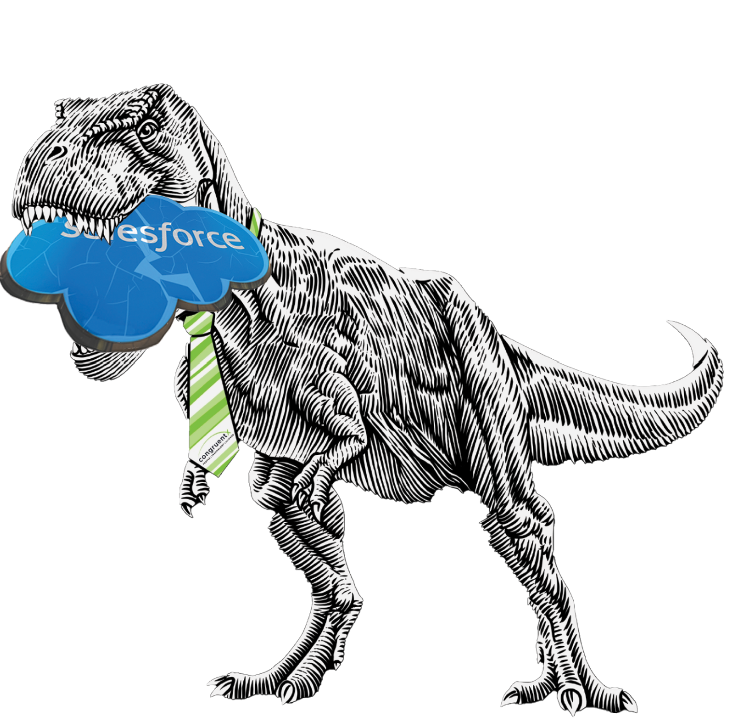
Finally! How to Accelerate Revenue and Salesforce takeouts with AI Fueled Business Outcomes – Guaranteed.
CongruentX does this through -
SalesforceSwitch – Build a Revenue Based Business Case for Salesforce Replacement www.salesforceswitch.com
Onboarding Copilot – D365 Sales and Service
Drive Revenue, Active Usage, Expansion and Renewals with our RevenuePulse Tech Enabled Services Subscription
Key Contacts | Chuck Ingram, CEO Avi Gupta, CFO and COO Chris Cognetta, MVP, CTIO Tasha Widhson, Marketing Mike Hauck, Value and Experience Officer
Microsoft Contacts | PDM: Howard Walovitch
Practice | Dynamics 365 CE Power Platform Coplot Business Value
Industry Focus | Insurance Financial Services Professional Service Wholesale Distribution
Regional Coverage | United States
Engaged Districts | Southcentral - SMC Midwest - SMC Southeast - SMC Northeast & Mid-Atlantic – SMC and Enterprise Incubating West – SMC
Specializations & Advanced Specializations | Dynamics CE Sales Customer Insights Power Platform – Power Apps Sales Co Pilot
Solutions Plays | Major Accelerate Revenue Copilot for Sales Minor Accelerate Innovation with Low Code
Partner Offers including Marketplace Offers & CSPS | Get Sales Copilot Right in 30 Days Get/Start CRM Right In 30 Days Pulse Subscription for D365 CE Sales
Position congruentX If: Your Customer has Salesforce.com and has invested in MS stack. Salesforce is expansive and is creating friction not fuel. I need to a Salesforce takeout but show real value for the change. Salesforce Replace - Start CRM Right with AI Fueled Selling – Build a Revenue Based Business Case for Salesforce Replacement – www.salesforceswitch.com Salesforce Surround - Get CRM Right – Begin with Salesforce Surround Using Sales Copilot, Dialogue Prime, and Power Platform Usage and Renewals - Your customer has Dynamics 365 CE, they aren't getting the results they hoped for so you can’t drive active usage or expansion revenue. #getcrmright Your Customer is in Insurance, Professional Services or Wholesale Distribution Industries | Managed Services: Partner has a unique AI enabled subscription offering for D365 CE and Power Platform featuring Revenue Pulse Monitoring Unlimited Support with SLA Backlog Management and Prioritization Enhancement and Expansion Sprints Environment and Azure consumption monitoring User Adoption monitoring Business outcome monitoring and alignment Revenue Operations as a Service
congruentX Competitive Advantages Built from the Ground Up to Align Business and Tech around Outcomes Senior team with leadership roles at large partners with large implementations Unique implementation approach based on a Low Friction Land then Expand and Achieve Outcomes High Customer Satisfaction Active Usage and Re-Engagement Percentage | Customer Case Study: Rollins Inc 2.6m D365 Sales Problem Rollins, Inc. is a global pest control company serving residential and commercial clients. The executive team in charge of the contact center believed they have a go to market strategy to get to 500 million from 350 million just not the technology. Approach and Solution The Microsoft team leveraged programs to offer Rollins the best value possible including licensing discounts, ECIF. Salesforce offered similar concessions to match every discount A very key learning was focusing on business outcomes as the big differentiator to help win the business. Outcomes CongruentX went deep on the outcomes side with Rollins. CX even offered a financial guarantee ensuring that with the implementation of the Microsoft solution Rollins would grow overall revenue by over 16.9 million in the first-year post go live and put consulting revenue on the line in making that guarantee.
Key Reference | Customer Wins | 100% Referenceable
Best way to engage CongruentX:
By Scenario | By Territory | By Workload
Envisioning Lab Co Sell Days 1:1 Customer strategy CX|MSGetCongruent.com Digital Sales Rooms | Land – Get Copilot for Sales Right in 30 Days Expand – Get CRM Right in 30 Days Revenue, Active Usage and Renewals with our Revenue Pulse Managed Services + Offering | Business Applications Power Platform Copilot Azure

